Slide 1

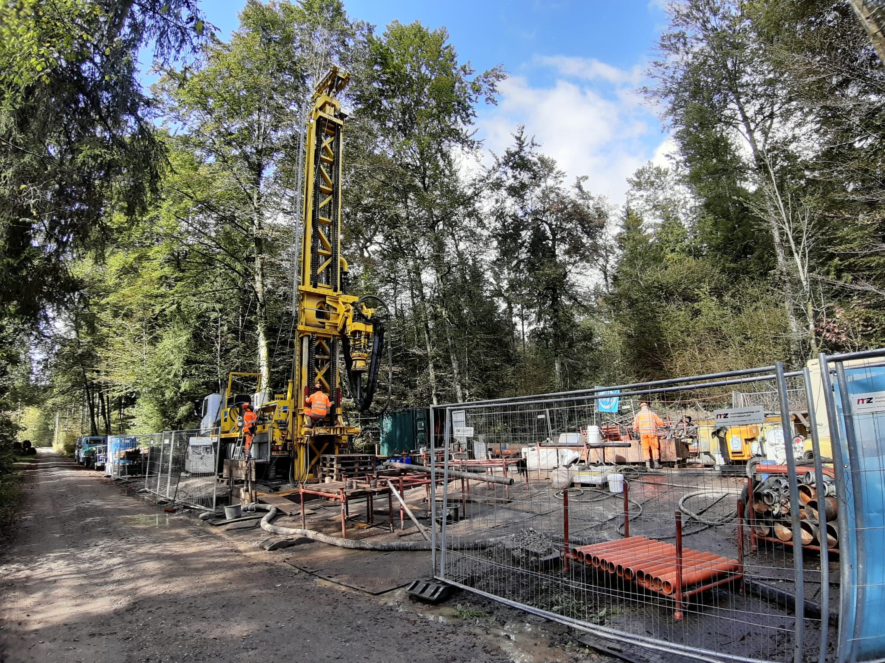


First steps into Image-based Classification of Sediments in Drill Cores
ADS CAS Module 6
18.04.2024
Sebastian Schaller and Patricio Becerra
Notes:
Patricio (30 sec)

Slide 2
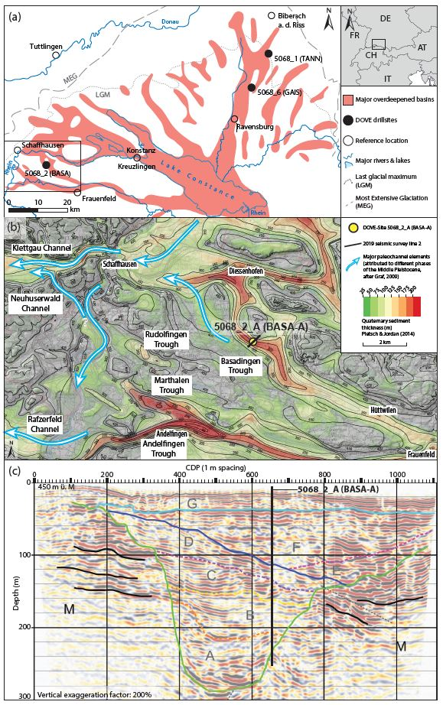
Introduction and background
Glacial extents of the Rhine Glacier
Seismic line
Local overdeepenings
Drill core
Notes:
Sebastian (1 min)

Slide 3
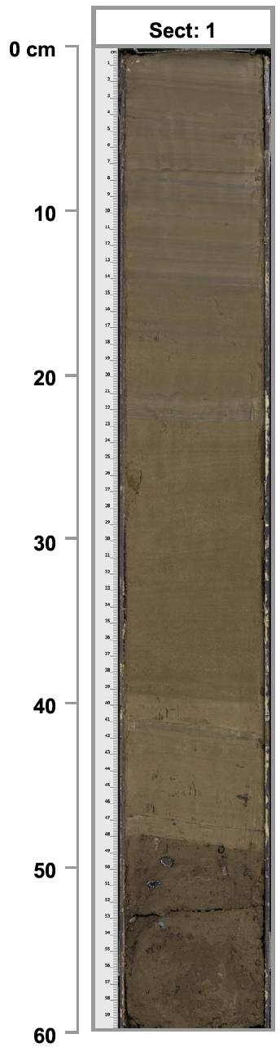
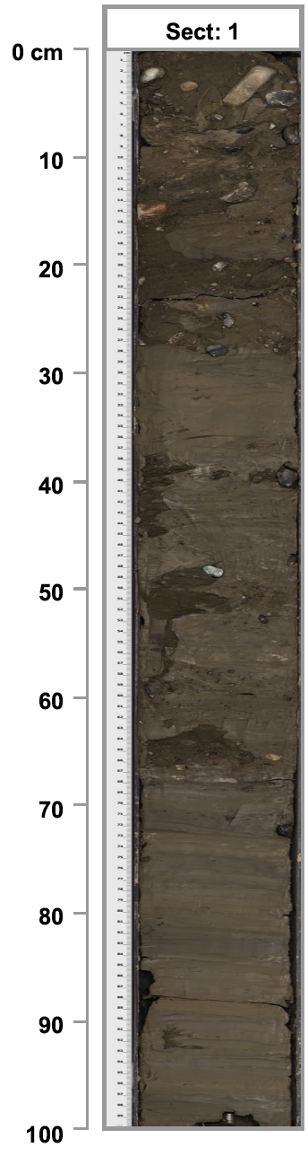
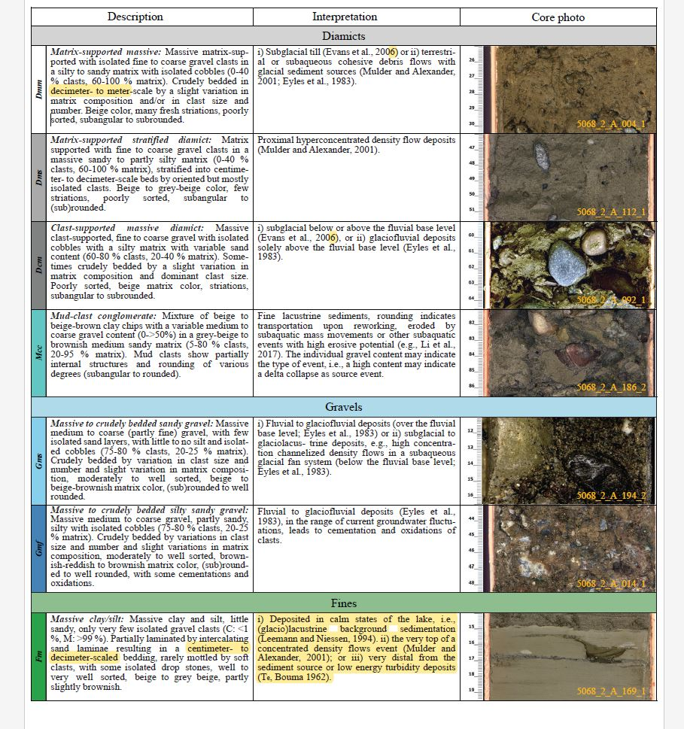
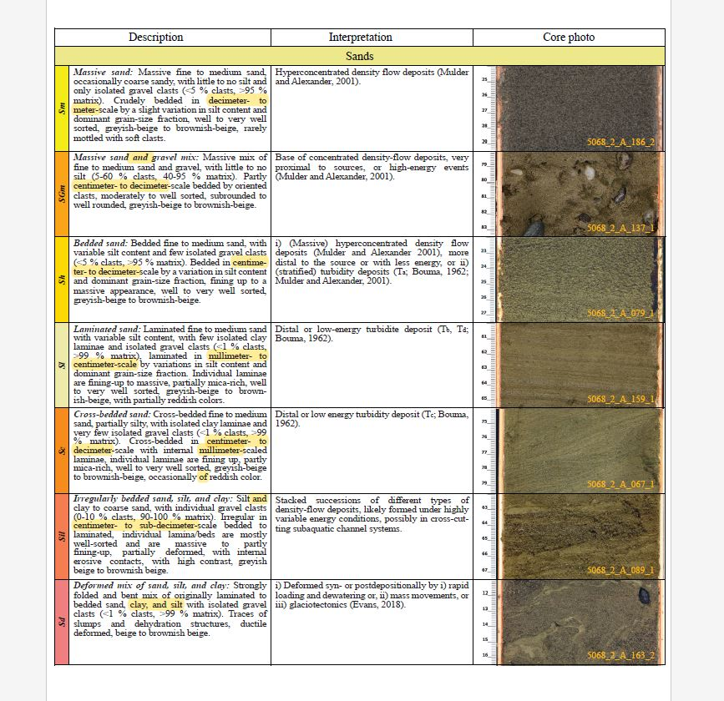
Introduction and background
High-resolution scanned images of sediment drill cores were used to classify the unconsolidated sediments into several lithoclastic types (e.g. gravel, sand, or fine clays)
The goal of the M6 project is to set the foundation for a deep learning model that can classify the sediments in a drill core image of unconsolidated quaternary sediments → Image segmentation
Our goal is for the full model to be half of our CAS project
Diamict
Gravel
Advantages:
Visual litho-classification takes months
Optimizes the development of stratigraphic models
Sand
Fines
Notes:
Patricio (1 min)

Slide 4
Module 6 Tasks & Objectives
Create training, test and validation datasets from a subset of the previously visually litho-classified images
Label the image data → i.e. manually create image segmentation masks for the selected subset of previously classified images
Test out a model based on similar image segmentation models in the literature [e.g. DiMartino et al., 2023]
Evaluate initial results and obtain advice from CAS on how to proceed
Notes:
Patricio (30 sec)

Slide 5
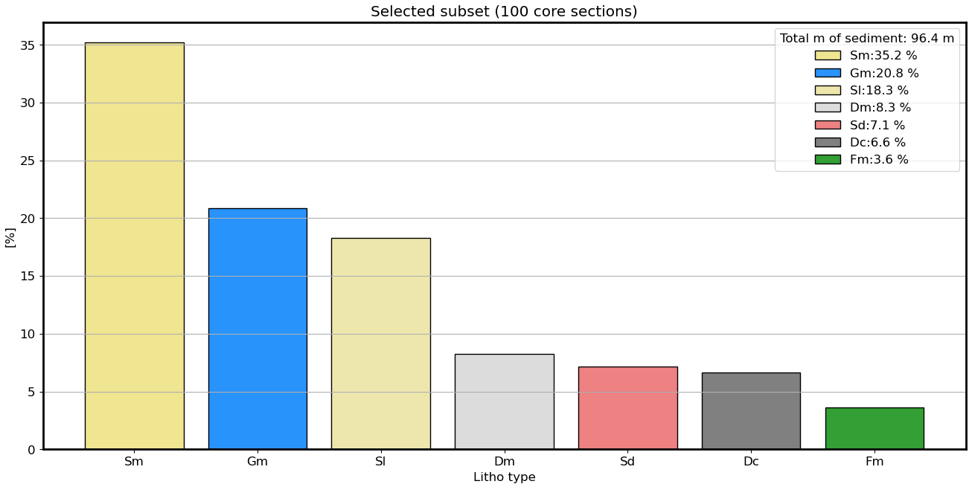
Dataset selection
Notes:
Sebastian (30 sec)

Slide 6
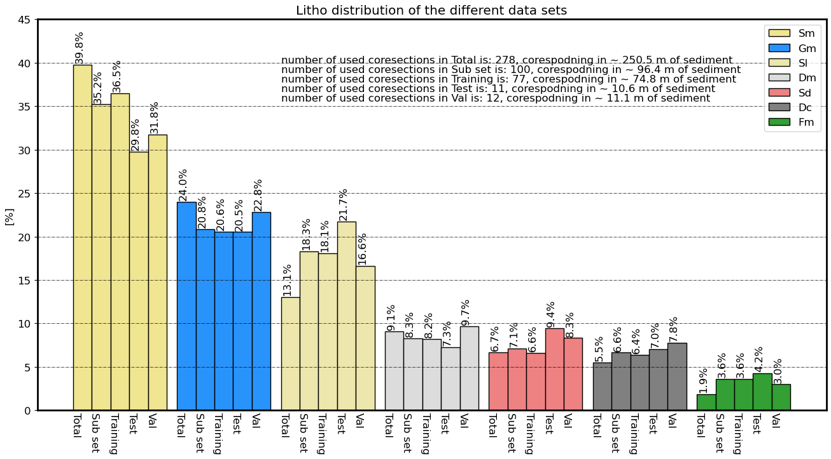
Dataset selection
Notes:
Sebastian (30 sec)

Slide 7
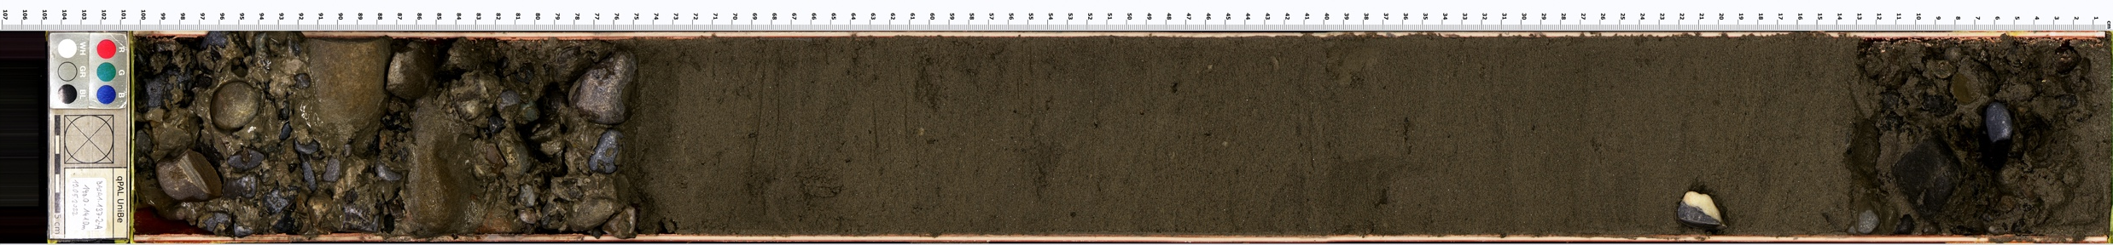

Data labeling: Manual image segmentation
Creating image masks
Massive Gravel
Massive Gravel
Laminated Sand
Notes:
Sebastian (30 sec)

Slide 8
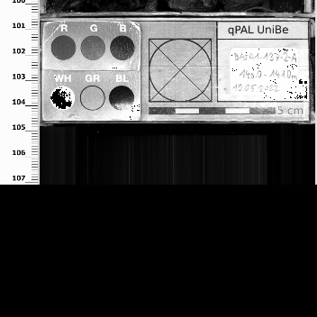
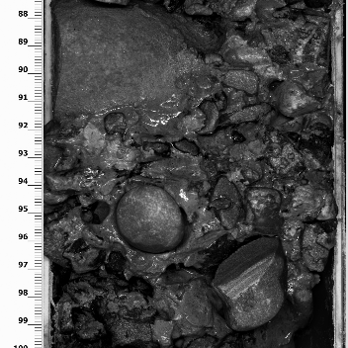
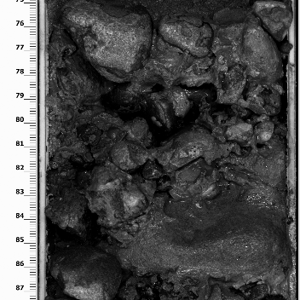
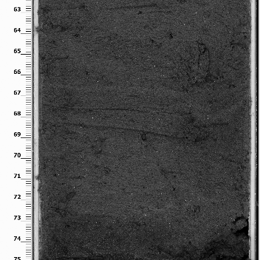
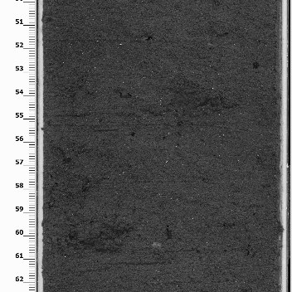
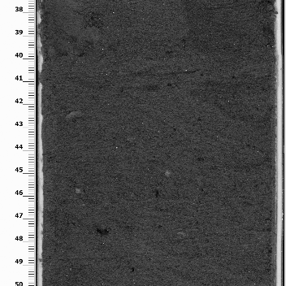
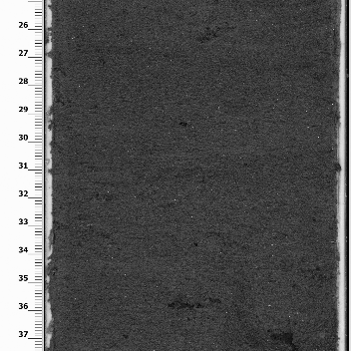
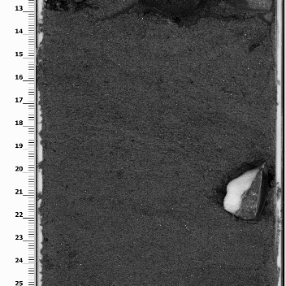
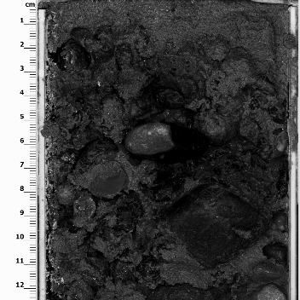






Data Processing: Image splitting
Massive Gravel
Massive Gravel
Laminated Sand
Notes:
Sebastian (30 sec)

Slide 9
Deep-learning model
Model architecture: U-Net (Tensorflow). Selected based on DiMartino et al., 2023
Used tutorial model: https://youtu.be/XyX5HNuv-xE?si=ywxtReVqf1nxxlzZ
Number of classes: 8
Optimizer: Adam
Loss functions attempted: Categorical cross-entropy; Focal loss
Datasets: 77 images for training; 11 images for testing; 12 images for validation; tried train_test_split
Tested several epochs and batch sizes
Notes:
Patricio (30 sec)

Slide 10
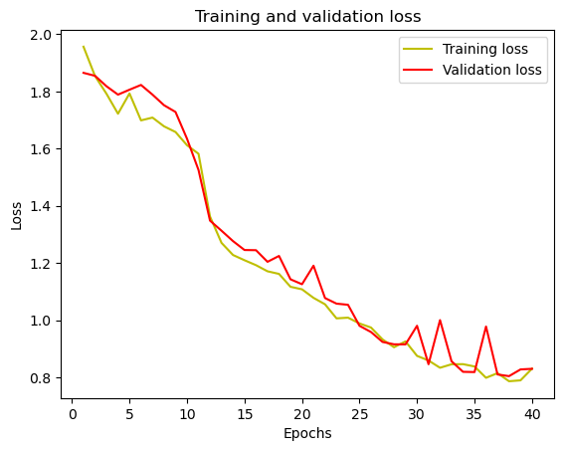
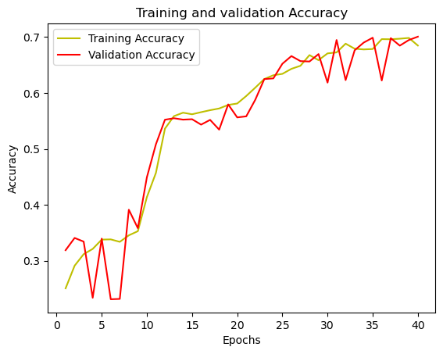
Example results
Best model so far: Random splitting, 40 epochs, 10 batches, categorical_crossentropy
IoU of class 0 is: 0.8748682
IoU of class 1 is: 0.6471699
IoU of class 2 is: 0.37699103
IoU of class 3 is: 0.109560125
IoU of class 4 is: 0.6387318
IoU of class 5 is: 0.55518365
IoU of class 6 is: 0.15295659
IoU of class 7 is: 0.0
Notes:
Patricio (30 sec): Increase epoch number (hyperparameter tuning). nnUNet.

Slide 11
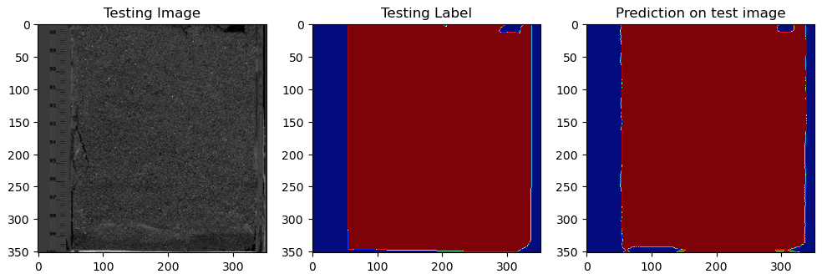
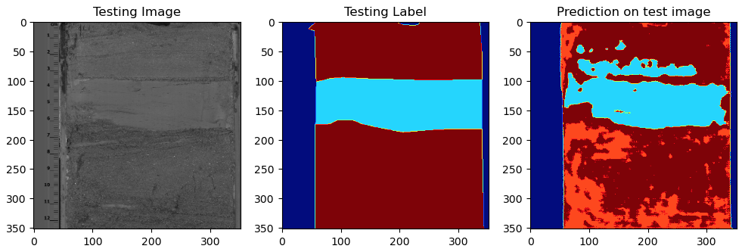
Example results (8 classes)
Go to notebook
Notes:
Patricio (30 sec)

Slide 12
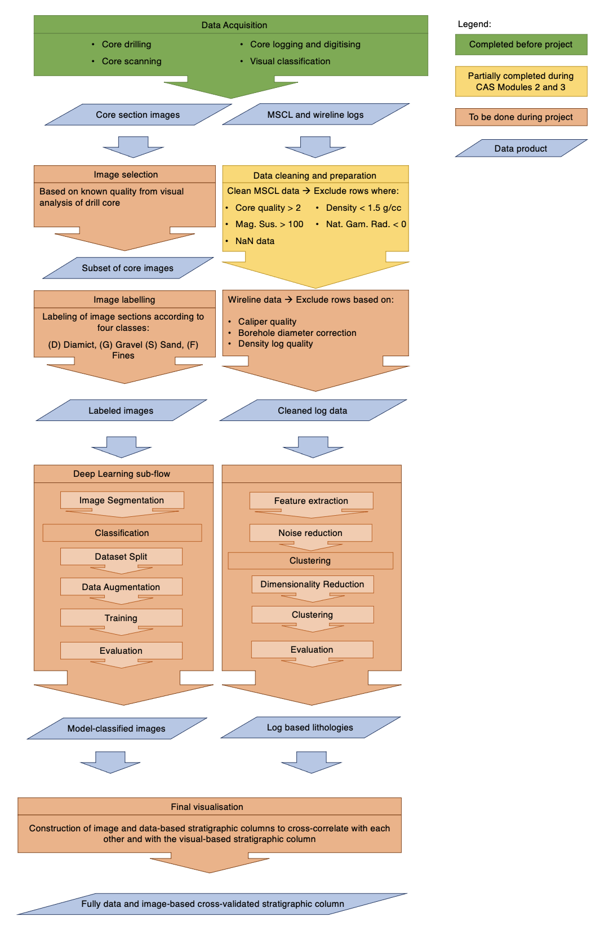
Next Steps
Try using fewer classes (e.g. 4 classes, like Module 3)
Increase training dataset (up to 1000 images available)
Try validation set
Improve Deep Learning toolset : Tensorflow → Pytorch
Try U-Net pre-trained on ImageNet with various backbones (e.g. EfficientNet)
Data augmentation
Notes:
Patricio (30 sec)

Slide 13
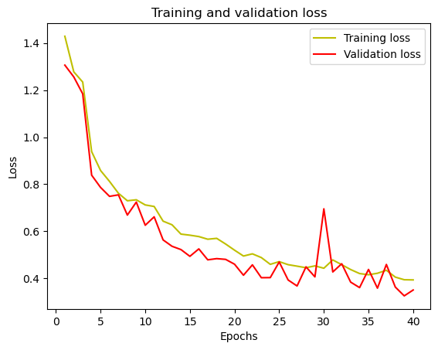
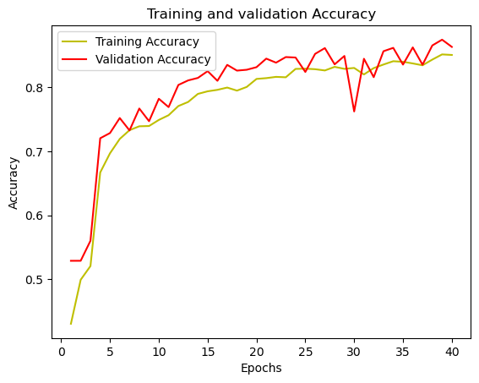
Example results (5 classes – Training set)
Best model so far: Random splitting, 40 epochs, 10 batches, categorical_crossentropy
Accuracy is: 86.3%
Mean IoU is: 0.612
iou of class 0 is: 0.8946793
iou of class 1 is: 0.5899338
iou of class 2 is: 0.49658573
iou of class 3 is: 0.18805782
iou of class 4 is: 0.89107263
Notes:
This slide is wrong. Run the trained model on the validation dataset (ask chato)

Slide 14
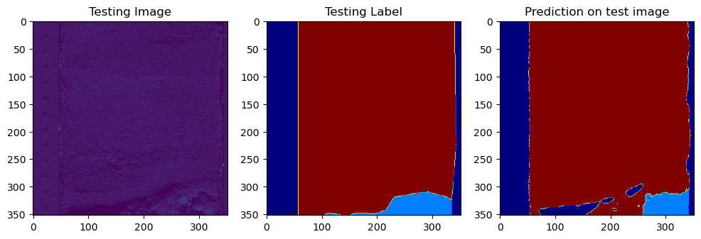
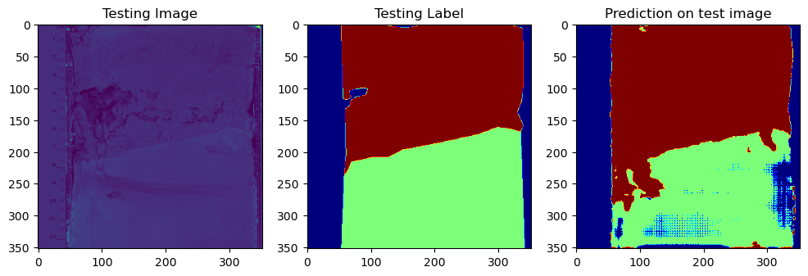
Example results (5 classes – Training set)
Go to notebook
Notes:
Patricio (30 sec)

Slide 15
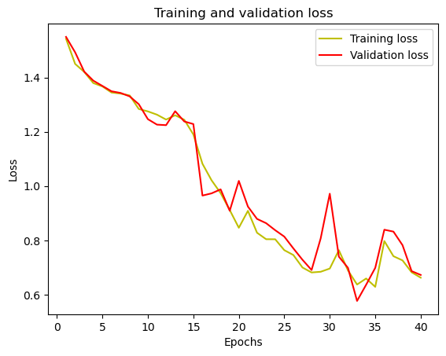
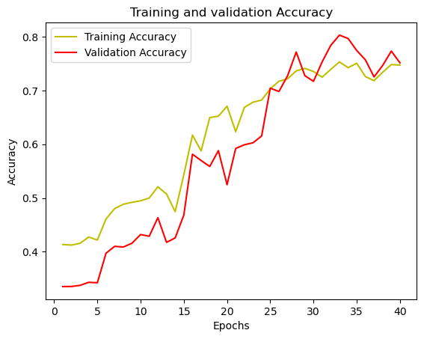
Example results (5 classes – Validation set)
Best model so far: Random splitting, 40 epochs, 10 batches, categorical_crossentropy
Notes:
This slide is wrong. Run the trained model on the validation dataset (ask chato)

Slide 16
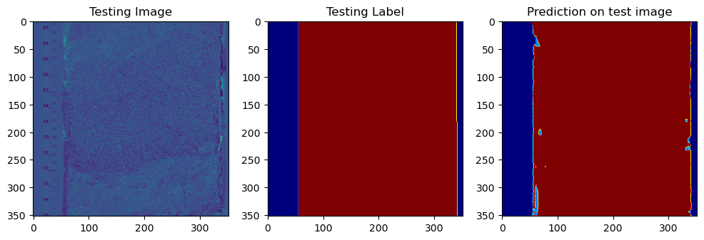
Example results (5 classes – Validation set)
iou of class 0 is: 0.7664793
iou of class 1 is: 0.43551743
iou of class 2 is: 0.0
iou of class 3 is: 1.0448119e-05
iou of class 4 is: 0.729131
Go to notebook
Notes:
This slide should stay but the results should be of the trained model ran on the validation dataset

